Slide 1

The Cloud: What’s Different?
Suman Debnath

Slide 2
Traditional Computing

Slide 3
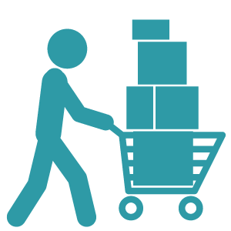
Traditional Computing (Hosting a Website)
Buy servers

Slide 4

Traditional Computing (Hosting a Website)
Buy servers
High traffic ?

Slide 5
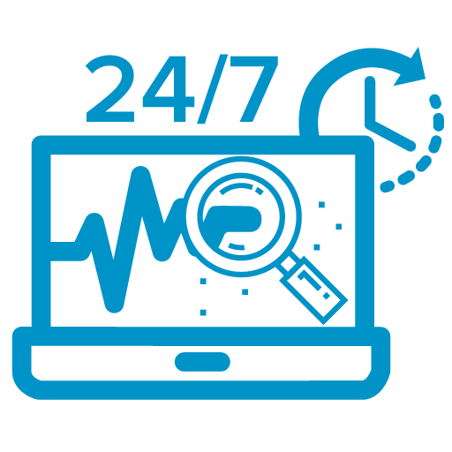
Traditional Computing (Hosting a Website)
Buy servers
High traffic ?
Monitoring and Maintenance

Slide 6

Pain points
Heavy upfront and maintenance cost

Slide 7
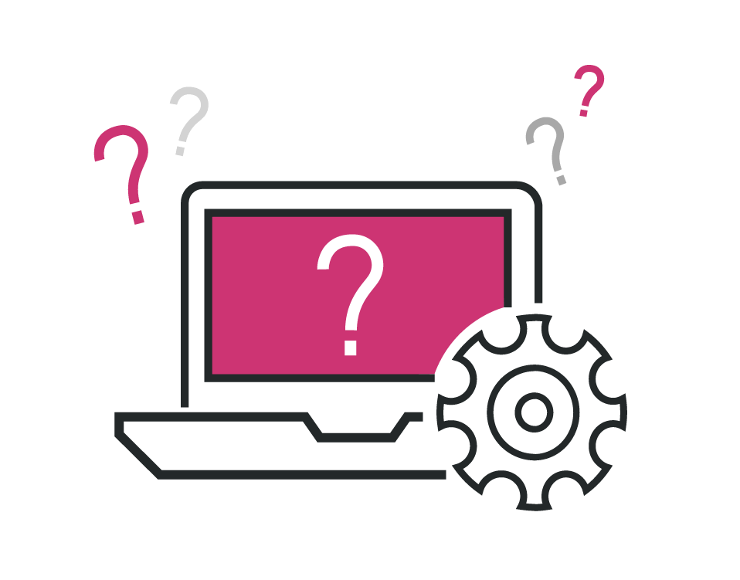
Pain points
Heavy upfront and maintenance cost
Troubleshooting can be tedious and may affect the business goals

Slide 8

Pain points
Heavy upfront and maintenance cost
Troubleshooting can be tedious and may affect the business goals
Inefficient use of hardware and resources as the traffic varies

Slide 9
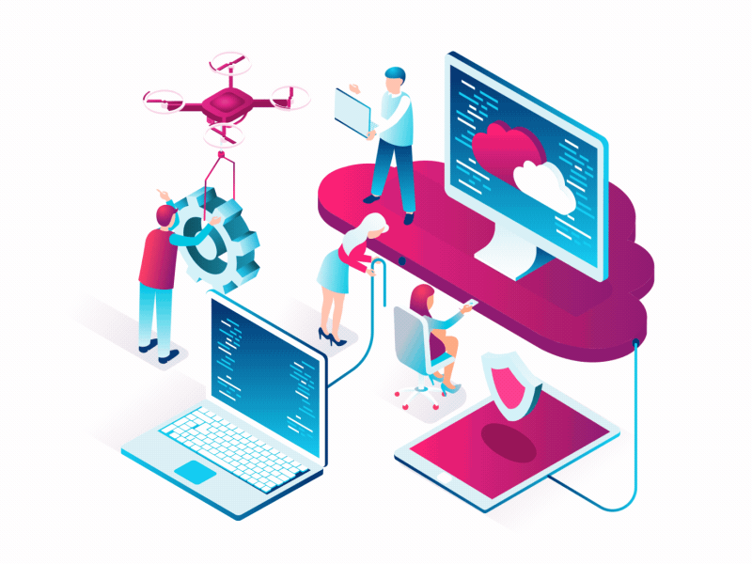
Comes the Cloud Computing…

Slide 10
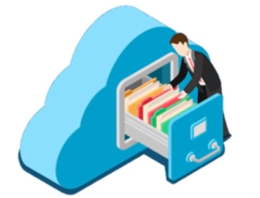
What is it ?
Store data/application on remote servers

Slide 11

What is it ?
Store data/application on remote servers
Access data/application over the internet

Slide 12
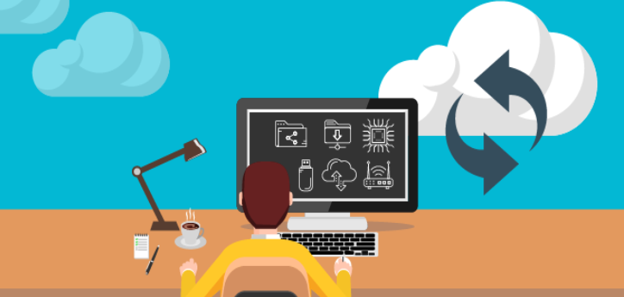
What is it ?
Store data/application on remote servers
Access data/application over the internet
Process data on remote servers

Slide 13
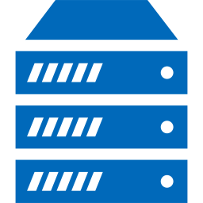
Traditional Computing
Physical Space
Power
Cabling
Networking
Racks
Servers
Storage
Certification
Infrastructure in Weeks

Slide 14
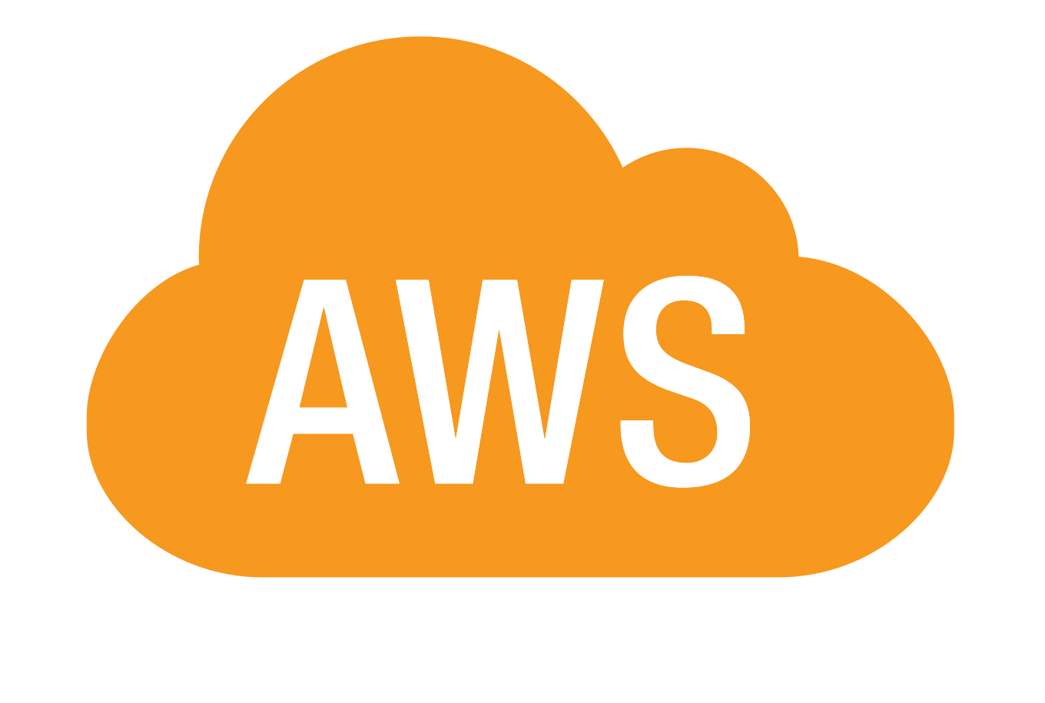
Cloud Computing - $0 to get started
Physical Space
Power
Cabling
Networking
Racks
Servers
Storage
Certification
Infrastructure in Weeks
0$ to get started
No long-term commitments
Pay as you go
Infrastructure in Minutes

Slide 15


Agility and Innovation

Slide 16
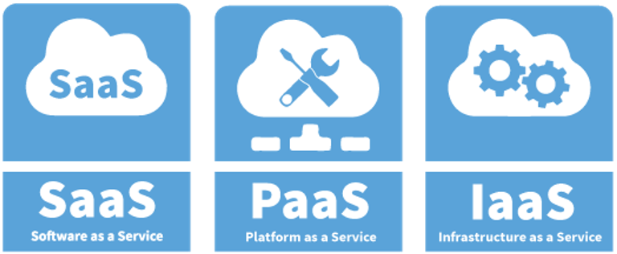
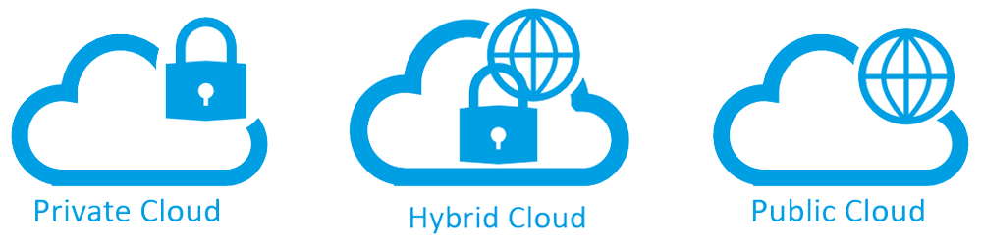
Cloud Models
Cloud Models
Service Models
Deployment Models

Slide 17
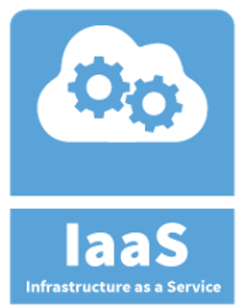
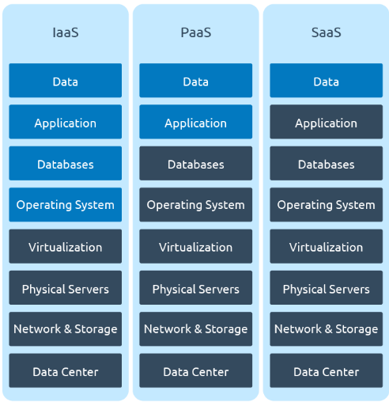

Service Models - IaaS
Provides access to fundamental resources such as virtual machines, virtual storage, etc.
No need to worry about the underling physical machines
Example: AWS

Slide 18
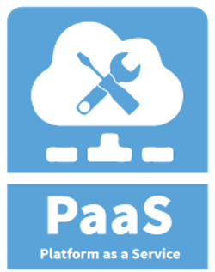
Service Models - PaaS
No control over the underlying OS, Storage, Server
The cloud provider gives the ability to the customer to deploy customer application using different programing languages, tools, etc.
Example: AWS Elastic Beanstalk

Slide 19
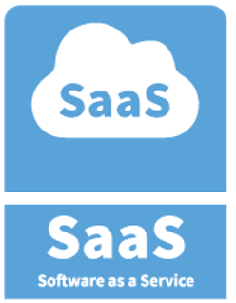
Service Models - SaaS
Operating environment is largely irrelevant
Cloud provider leases application or software which are owned by them
Example: Salesforce, Dropbox, etc.

Slide 20
Amazon Web Services(AWS)
Enable business and developers to use web services* to build scalable, sophisticated applications.
*what we call now “the cloud”

Slide 21
Traditional IT and AWS Core Services

Slide 22
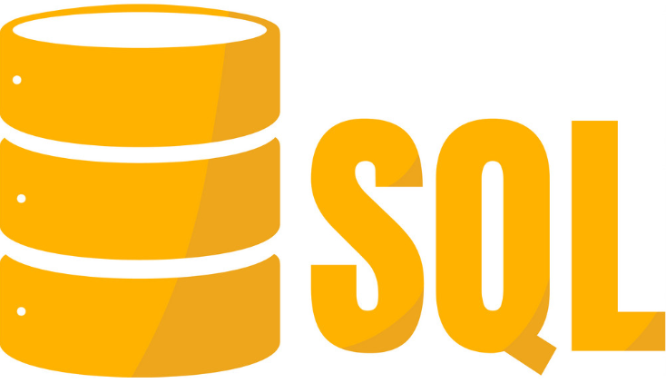
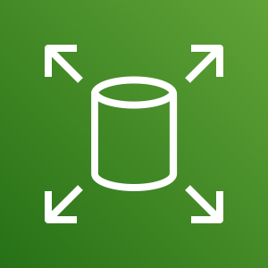
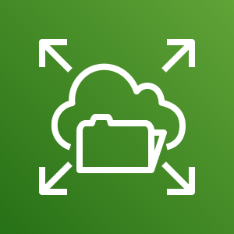

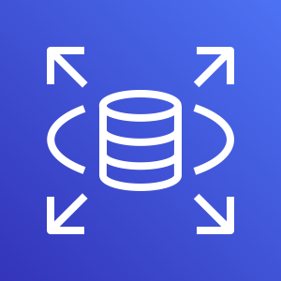
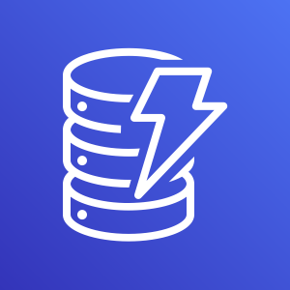
Traditional IT and AWS Core Services
EBS
EFS
S3
RDS
DynamoDB
SAN
NAS
DAS
Storage and Database

Slide 23
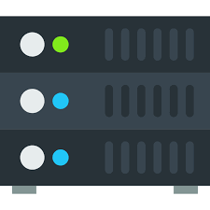

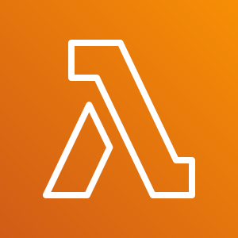
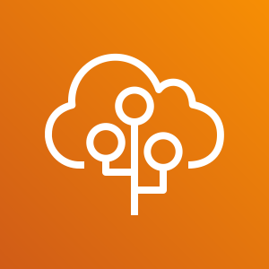


Traditional IT and AWS Core Services
Auto Scaling
Elastic Beanstalk
Compute
EC2
AMI
Lambda
Servers
EBS
EFS
S3
RDS
DynamoDB
SAN
NAS
DAS
Storage and Database

Slide 24
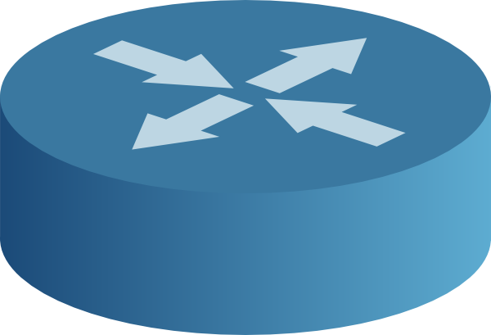
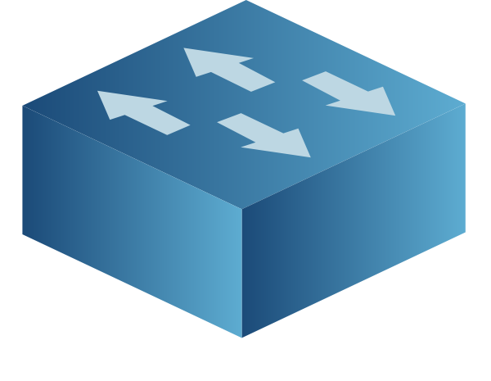

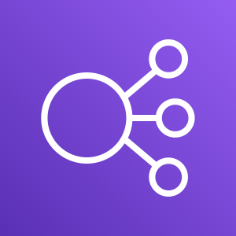

Traditional IT and AWS Core Services
Network
VPC
ELB
R53
Routers
Switches
Auto Scaling
Elastic Beanstalk
Compute
EC2
AMI
Lambda
Servers
EBS
EFS
S3
RDS
DynamoDB
SAN
NAS
DAS
Storage and Database

Slide 25
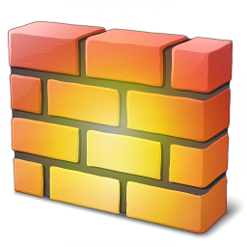
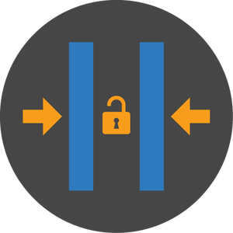
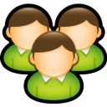





Traditional IT and AWS Core Services
IAM
Role
Permissions
Token
Firewall Manager
Security
Firewall
ACLs
Admins
Network
VPC
ELB
R53
Routers
Switches
Auto Scaling
Elastic Beanstalk
Compute
EC2
AMI
Lambda
Servers
EBS
EFS
S3
RDS
DynamoDB
SAN
NAS
DAS
Storage and Database

Slide 26

Its not all…

Slide 27

Its not all… Its just the Beginning with

Slide 28
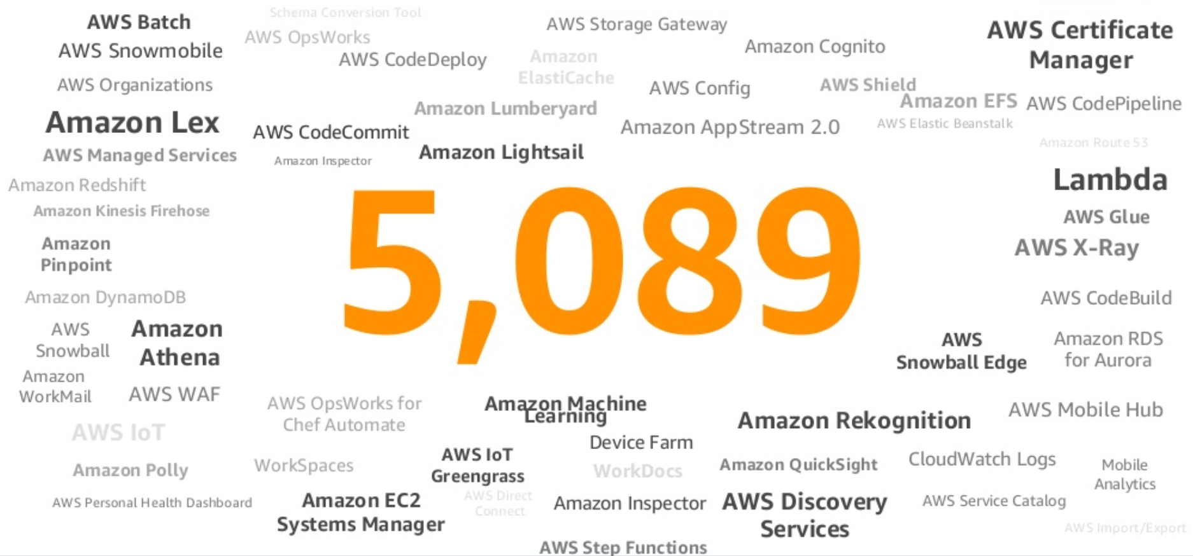
Services and Features

Slide 29




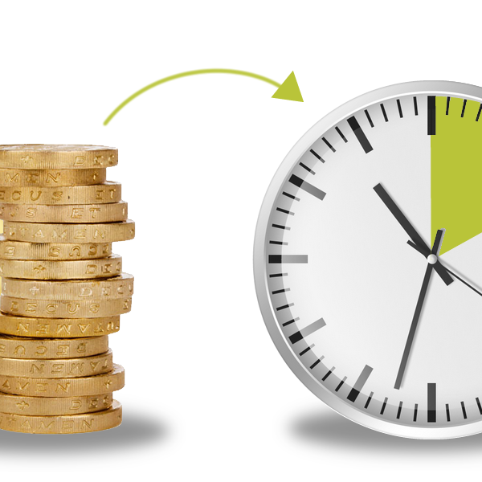
Advantage with AWS Cloud Computing
No more guessing
Go to Market @ speed
Agility and Scalability
Stop spending money on maintaining data centers
Pay as You Go

Slide 30



@_sumand
suman.san14@yahoo.in

